Slide 1
Foundations of Social, Cognitive, and Affective Neuroscience
PSY 511.003 Spr 2025

Slide 2
Overview

Slide 3
Prelude

Slide 4
https://www.youtube.com/embed/JB7jSFeVz1U
melodysheep (2011)

Slide 5
“If understanding everything we need to know about the brain is a mile, how far have we walked?”
National Geographic (2014)

Slide 6



Slide 7
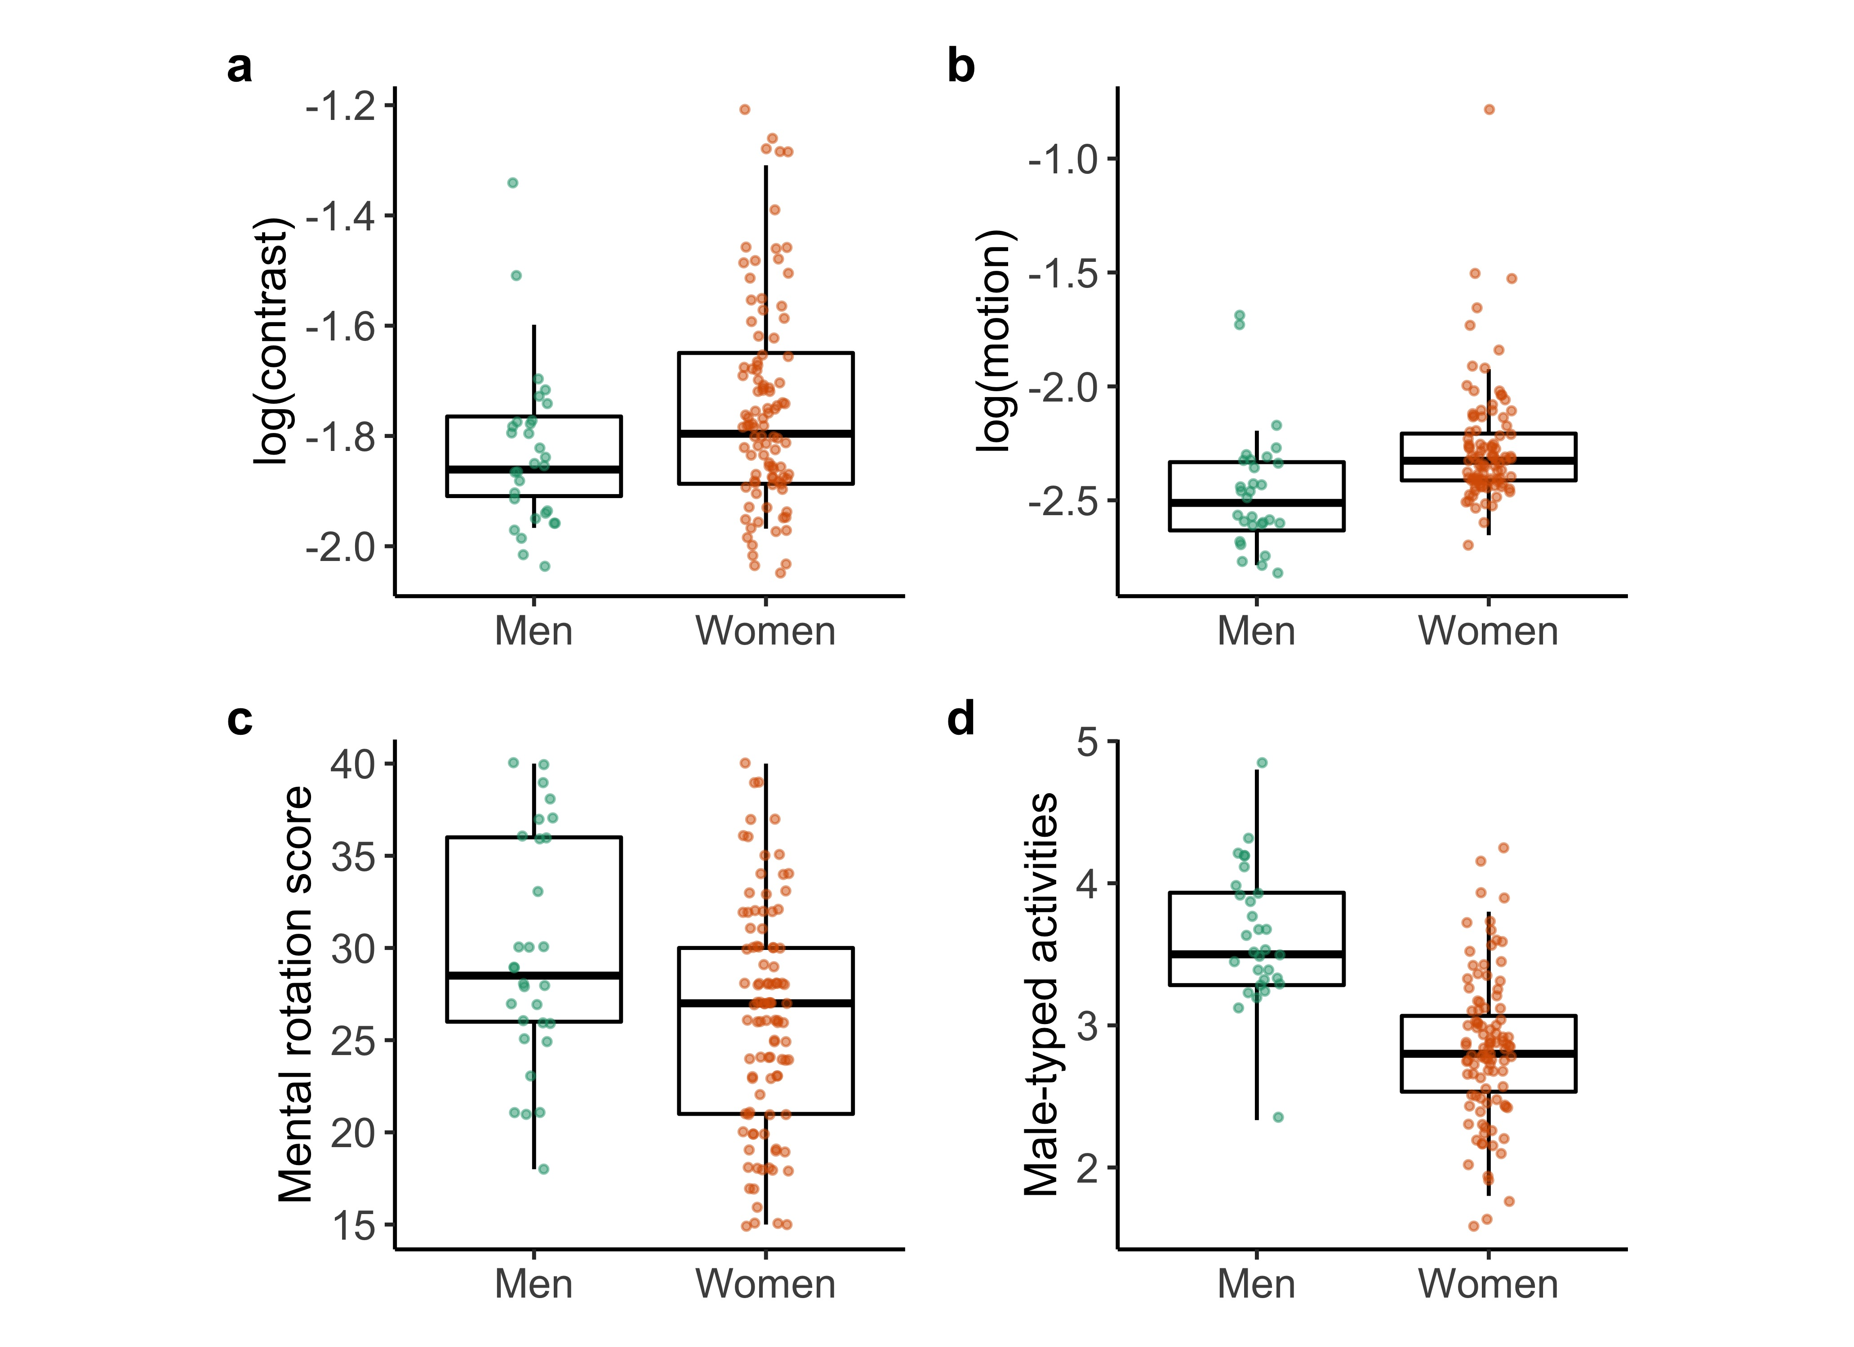
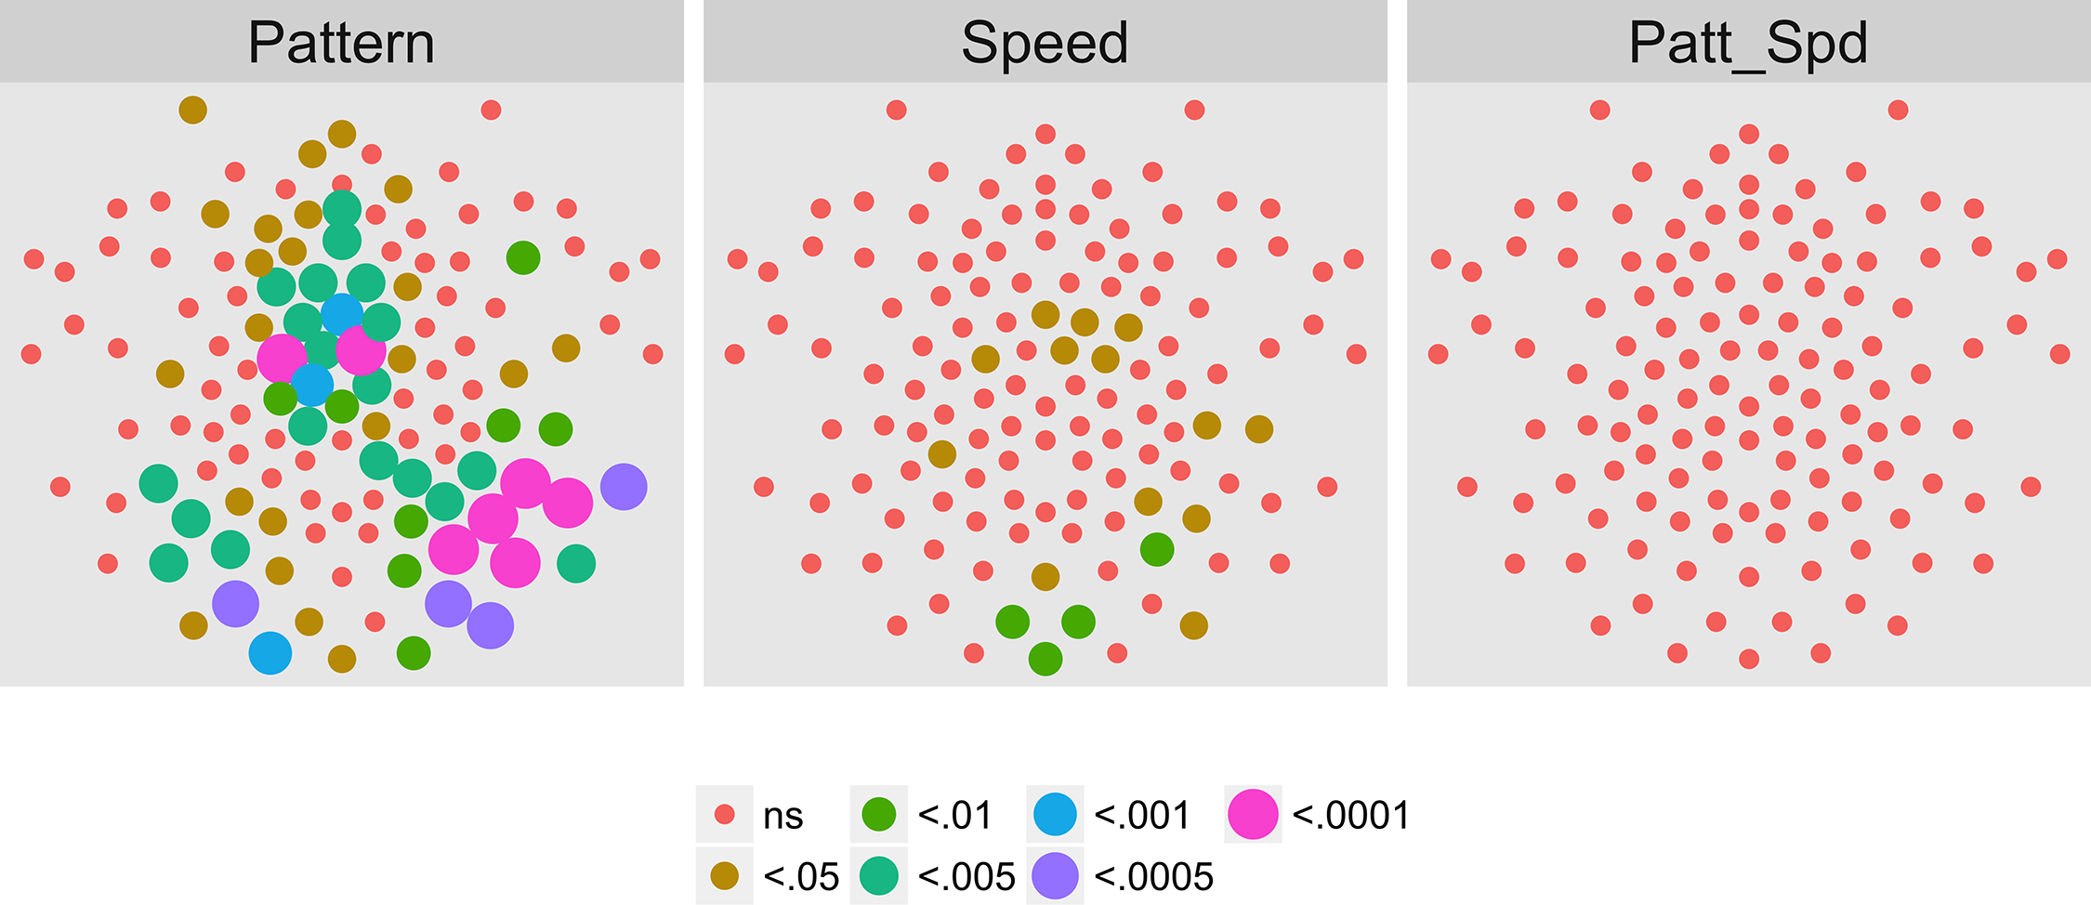

https://databrary.org
Qian et al. (2022)
Gilmore et al. (2016)

Slide 8



https://acousticbrew.org
https://www.nextstagetheatre.org
https://cpoclub.org

Slide 9
Today’s topics
Why neuroscience is harder than physics
Course overview
Does neuroscience need behavior? Does behavioral science need the brain?

Slide 10
Why neuroscience is harder than physics

Slide 11
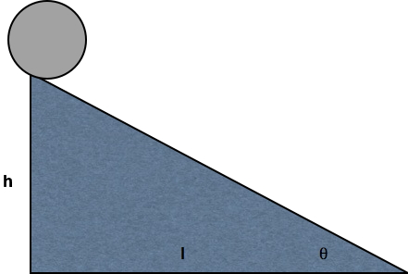

Slide 12
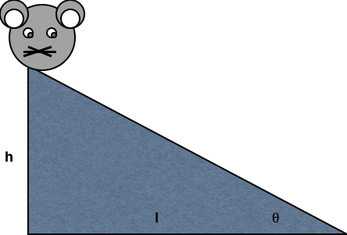

Slide 13
What do we need to know to answer the question?
What is the state…
Of the world ($W$)
Of the organism
Body ($B$)
Nervous system ($N$)
Mind ($M$)

Slide 14
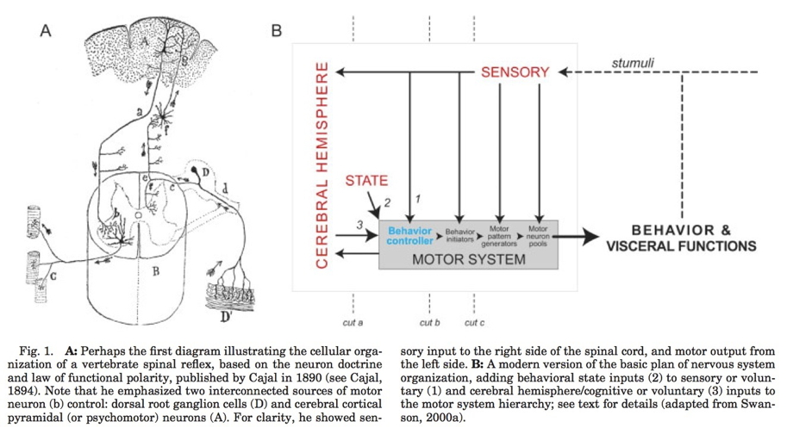
Nested state spaces
(Swanson, 2005, fig. 1)

Slide 15
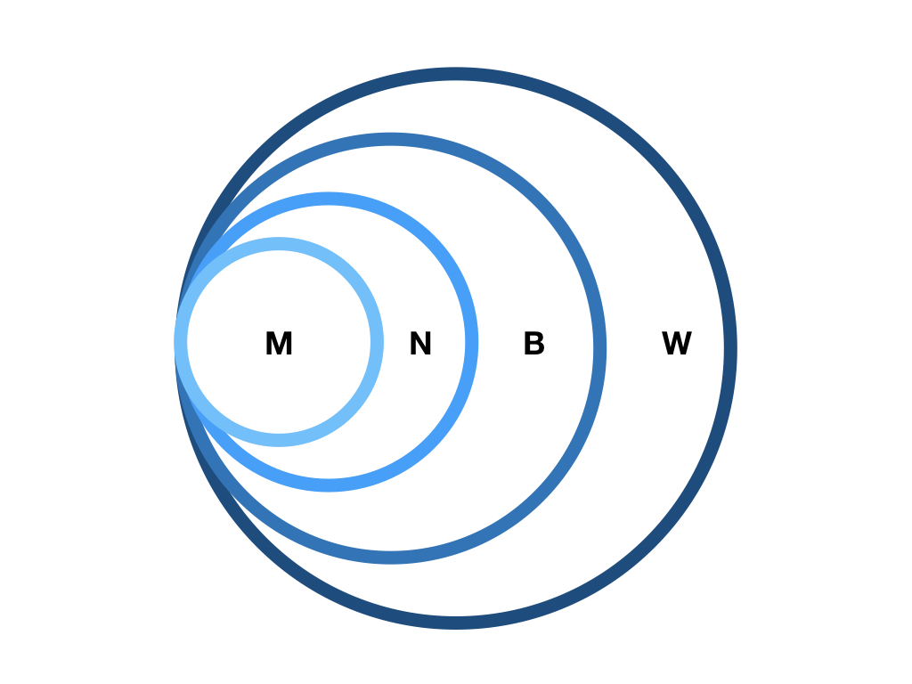

Slide 16
Some states are more easily measured than others
$W$, $B$, $N$ (more or less) directly

Slide 17
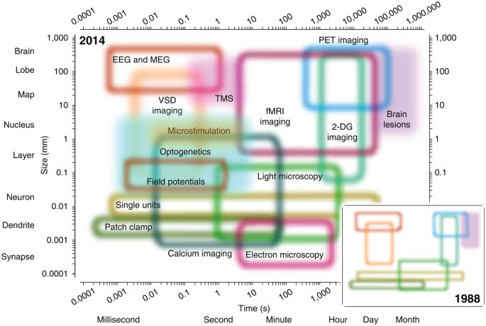
Sejnowski et al. (2014)

Slide 18
Mental states ($M$)
Measured indirectly
Via $N$, $B$, $W$
Do you agree?

Slide 19
What are essential components/dimensions of $W$?
To explain/understand $B$ (and $M$)

Slide 20
What are essential components/dimensions of $B$?
To explain/understand

Slide 21
Brain & behavior are complex, dynamic systems with
Components
Interactions
Forces/influences
Boundaries
Inputs/outputs/processes

Slide 22
Systems…
“Behave” or change state across time
Return to starting state
Appear to be regulated, controlled, influenced by feedback loops
$B\left(t+1\right)=f\left(W\left(t\right),B\left(t\right),N\left(t\right),M\left(t\right)\right)$

Slide 23
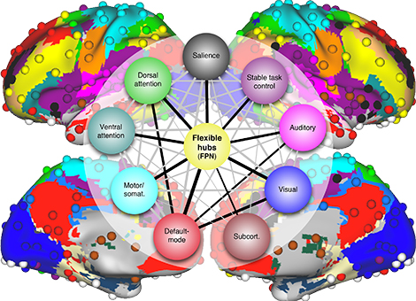
May be analyzed of as networks
From https://source.wustl.edu/2013/08/brain-flexible-hub-network-helps-humans-adapt/

Slide 24
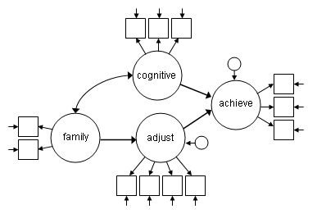
At multiple levels of organization…

Slide 25
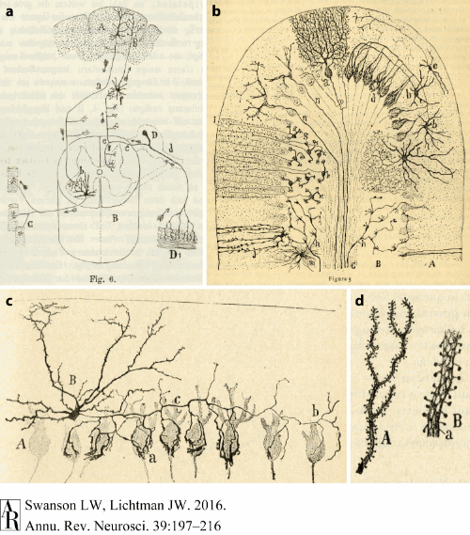
Swanson & Lichtman (2016) Figure 1

Slide 26
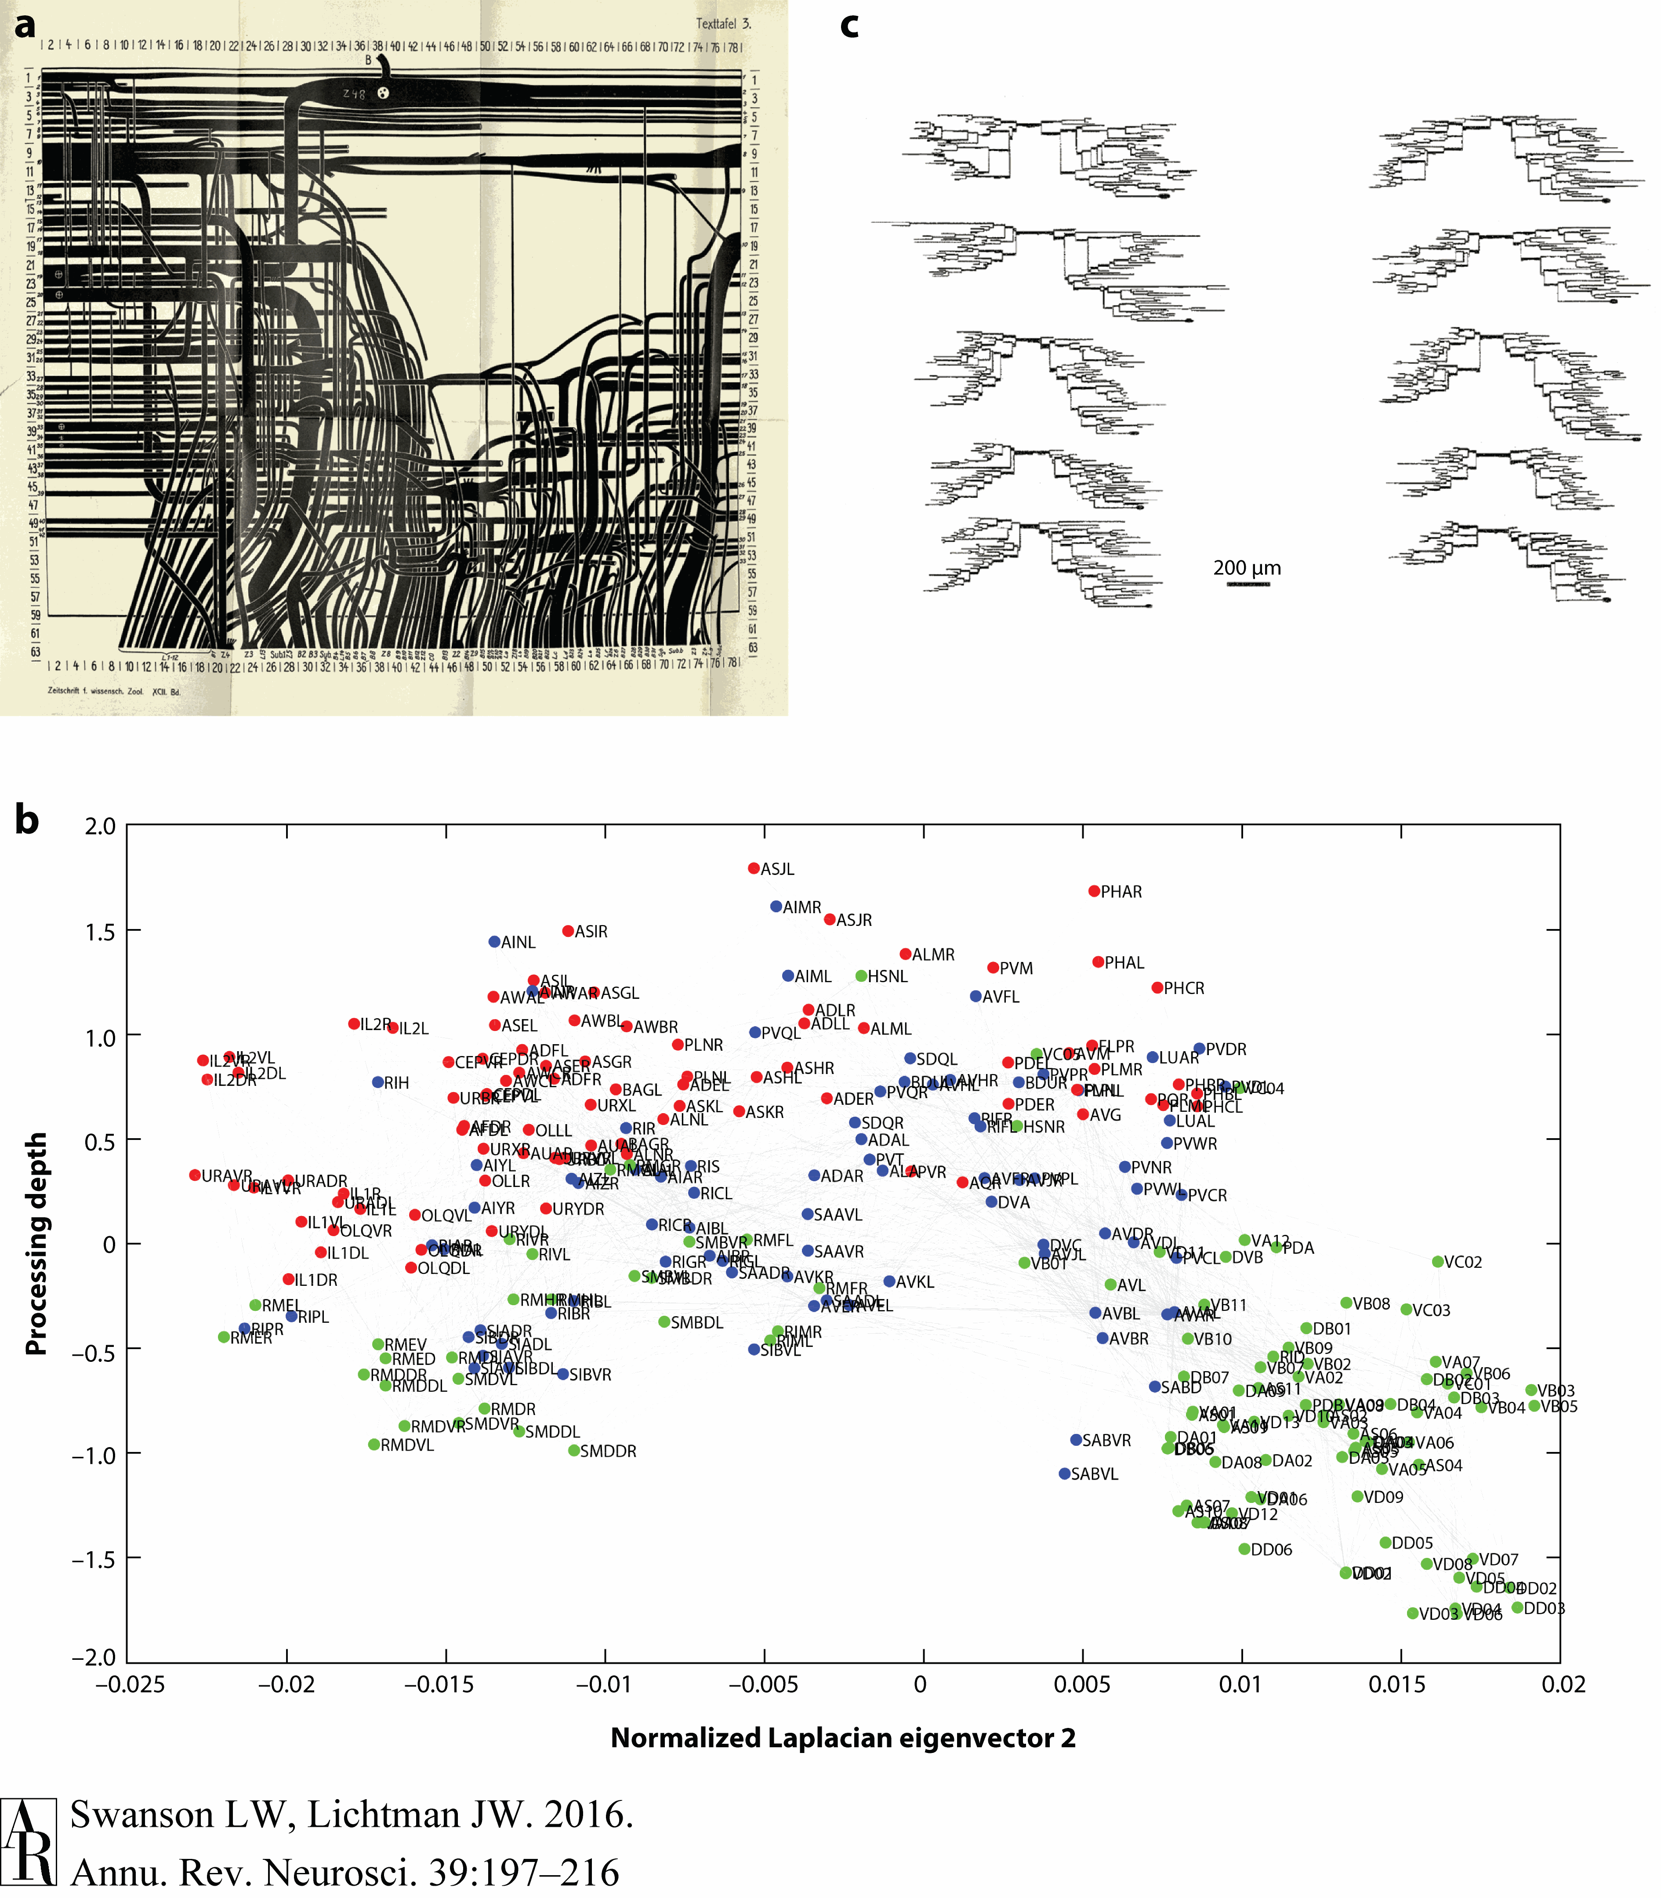
Swanson & Lichtman (2016) Figure 3

Slide 27
Hard to simplify
Consider a spherical cow
Computation (and memory) often distributed
Single functions -> multiple parts
By Keenan Crane; (The source material is licensed under CC0), CC BY-SA 4.0

Slide 28
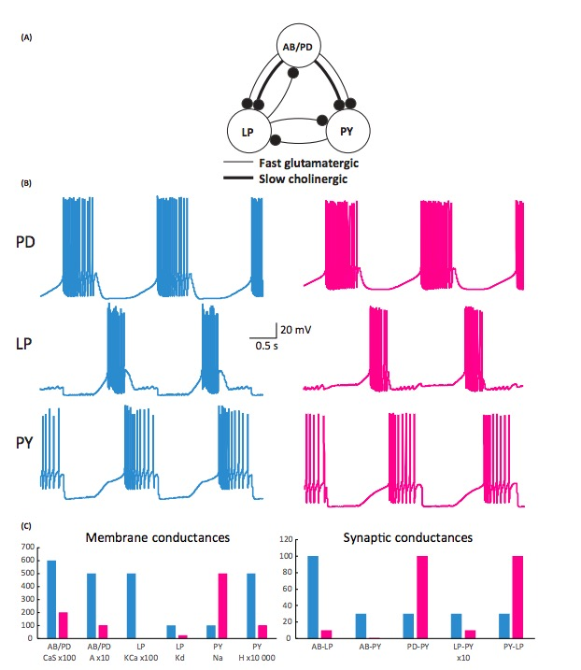
Single parts -> multiple functions
Many circuit wiring patterns
Similar dynamics
Calabrese (2018)

Slide 29
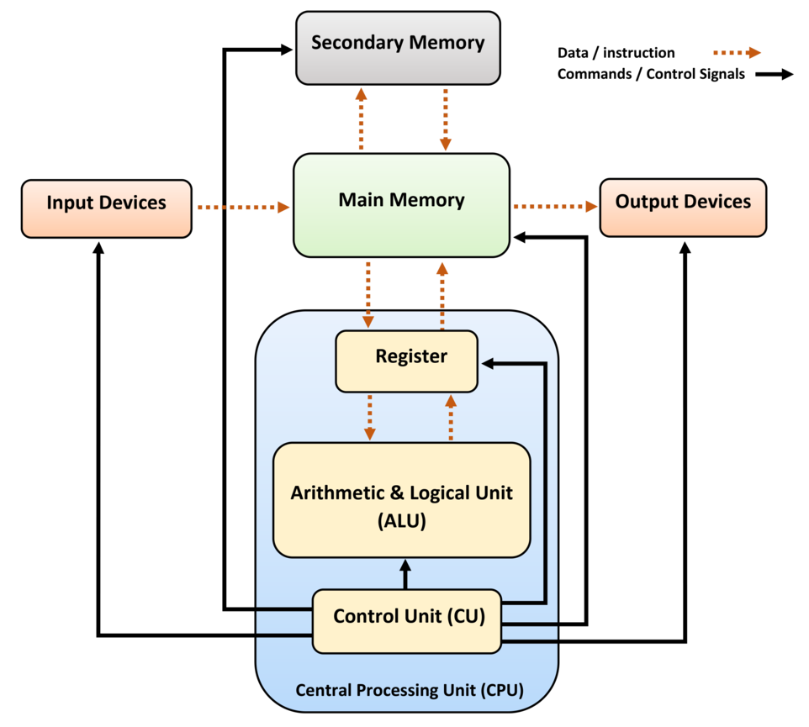
Biological systems not “designed”
…like human-engineered ones
https://en.wikipedia.org/wiki/Computer_architecture

Slide 30
Studying such systems is hard because…
Change structure/function over time
Hard to measure what is being exchanged, what is being controlled

Slide 31
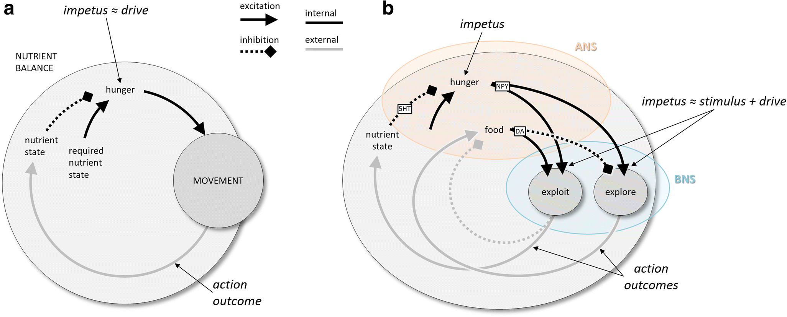
(Cisek, 2019, fig. 3). Schematic behavioral control systems. (A) When the current nutrient state deviates from a desired state, locomotion is initiated, ultimately bringing the animal to a more desirable state. (B) Elaboration of nutrient state control into a high-level controller (ANS) and a lower-level controller (BNS) capable of two modes of locomotion, local exploitation, and long-range exploration. 5HT, serotonin; ANS/BNS, apical/blastoporal nervous system; DA, dopamine; NPY, neuropeptide Y

Slide 32
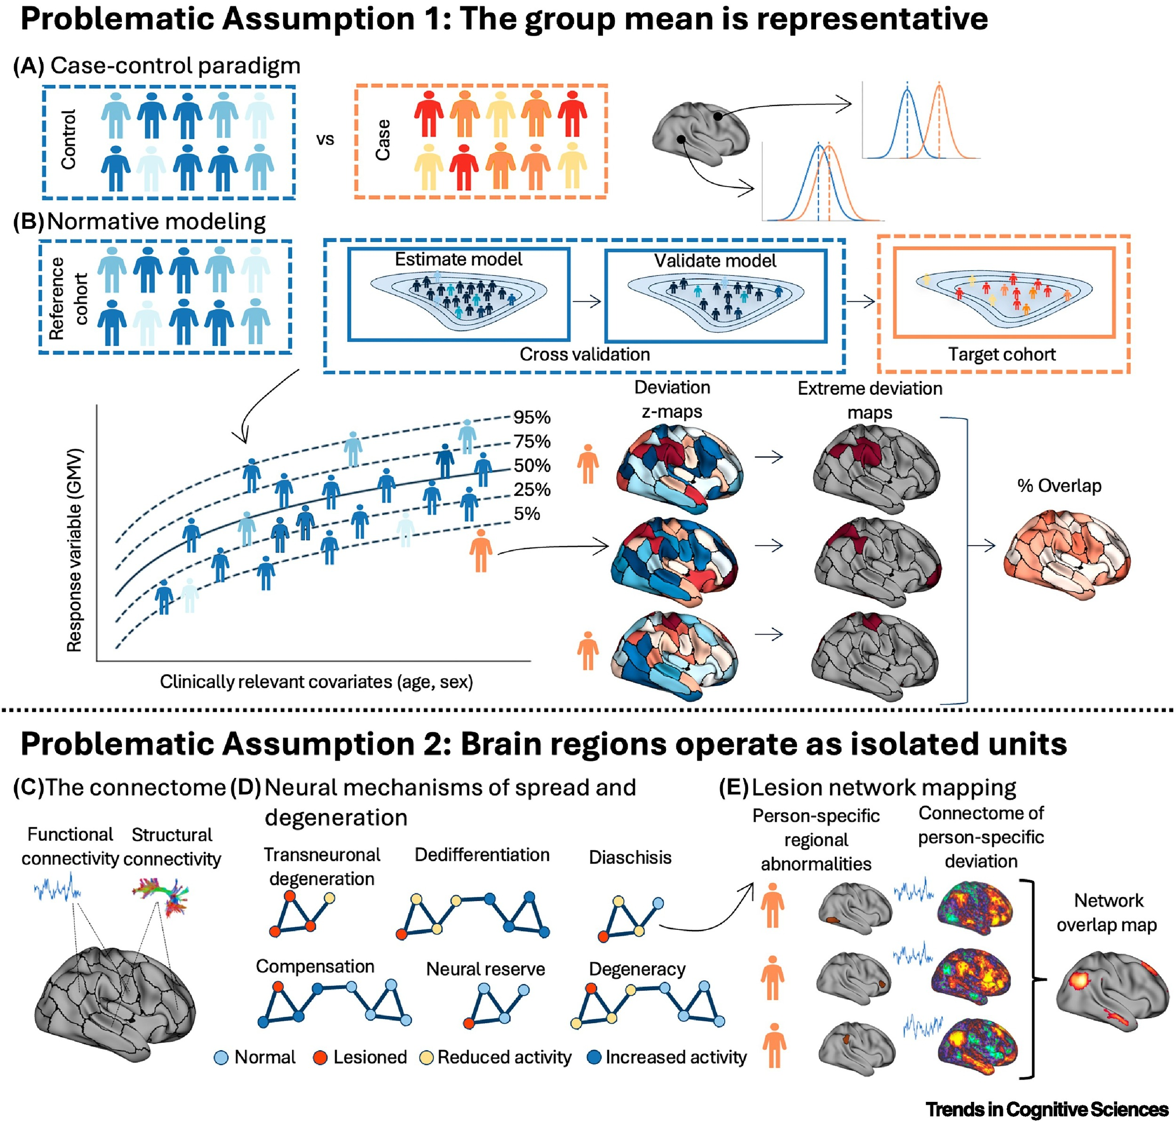
Assumptions are problematic
Segal et al. (2024)

Slide 33
Course overview

Slide 34
Goals
Master fundamentals of neuroscientific concepts and facts
Prepare to read primary source literature in social, behavioral, cognitive, affective, and clinical neuroscience

Slide 35
Structure
https://psu-psychology.github.io/psy-511-scan-fdns-2025-spring/

Slide 36
Questions
What is the basic organizational plan of the nervous system?
How do neurons work?
How do neurons connected in networks achieve behavioral goals?
How does the nervous system develop? How has it evolved?
How do disorders of the mind reveal themselves in the nervous system?

Slide 37
Approach
Brain architecture (neuroanatomy)
Brain function (neurophysiology)
Brain communication (neurochemistry)
Changes over evolutionary and developmental time

Slide 38
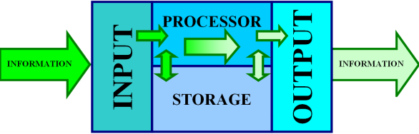
Approach
The nervous system as an information processing system
Wikipedia

Slide 39
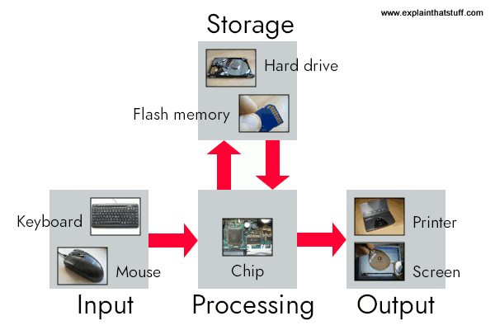
Mindful of limitations in brain/computer metaphors
https://www.explainthatstuff.com/howcomputerswork.html

Slide 40
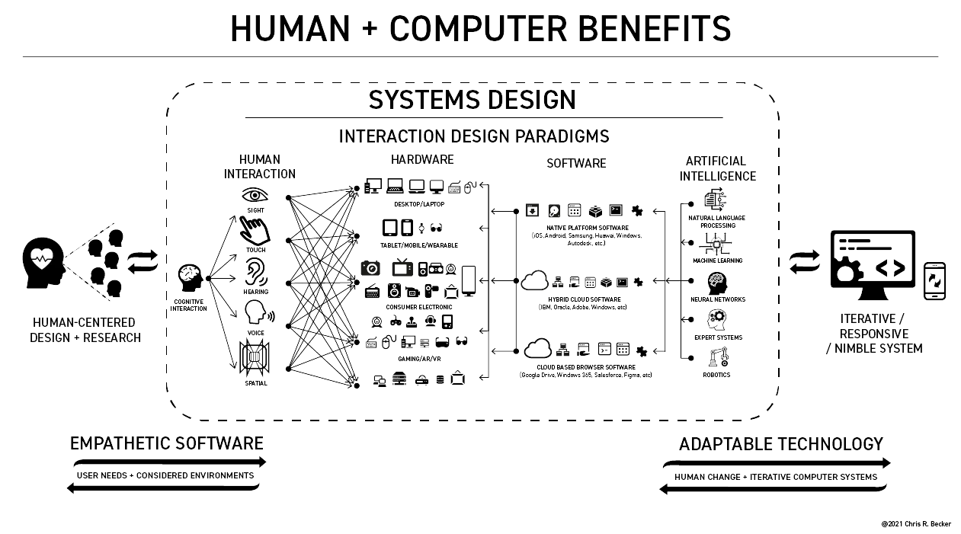
Or inspired by richer metaphors
Becker (2021)

Slide 41
Inputs
From environment, body, brain

Slide 42
Processing
Current inputs + brain state + body state + possible future states…
Stored information
Physiological & behavioral goals

Slide 43
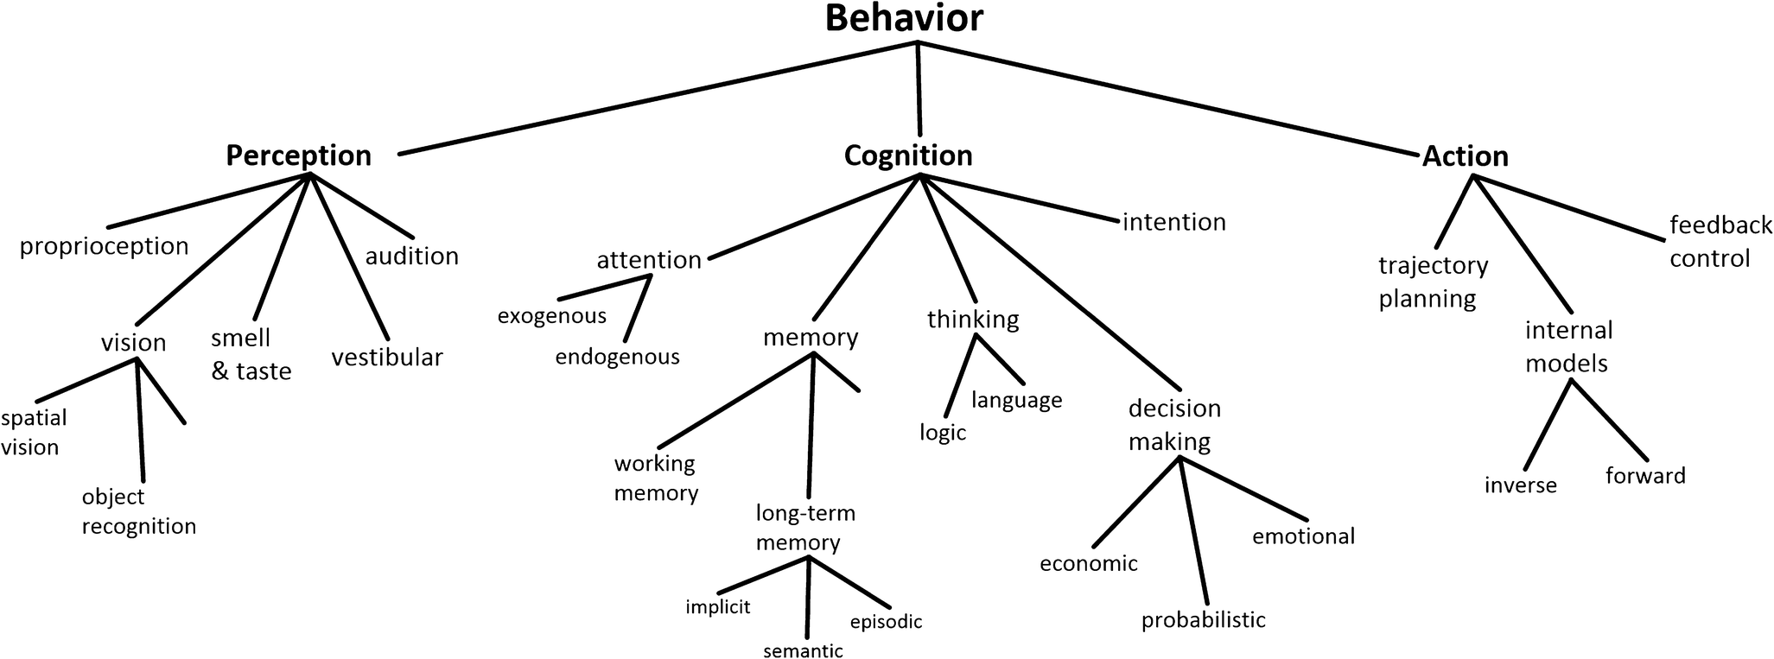
(Cisek, 2019, fig. 1)

Slide 44
Outputs
To brain, body, environment

Slide 45
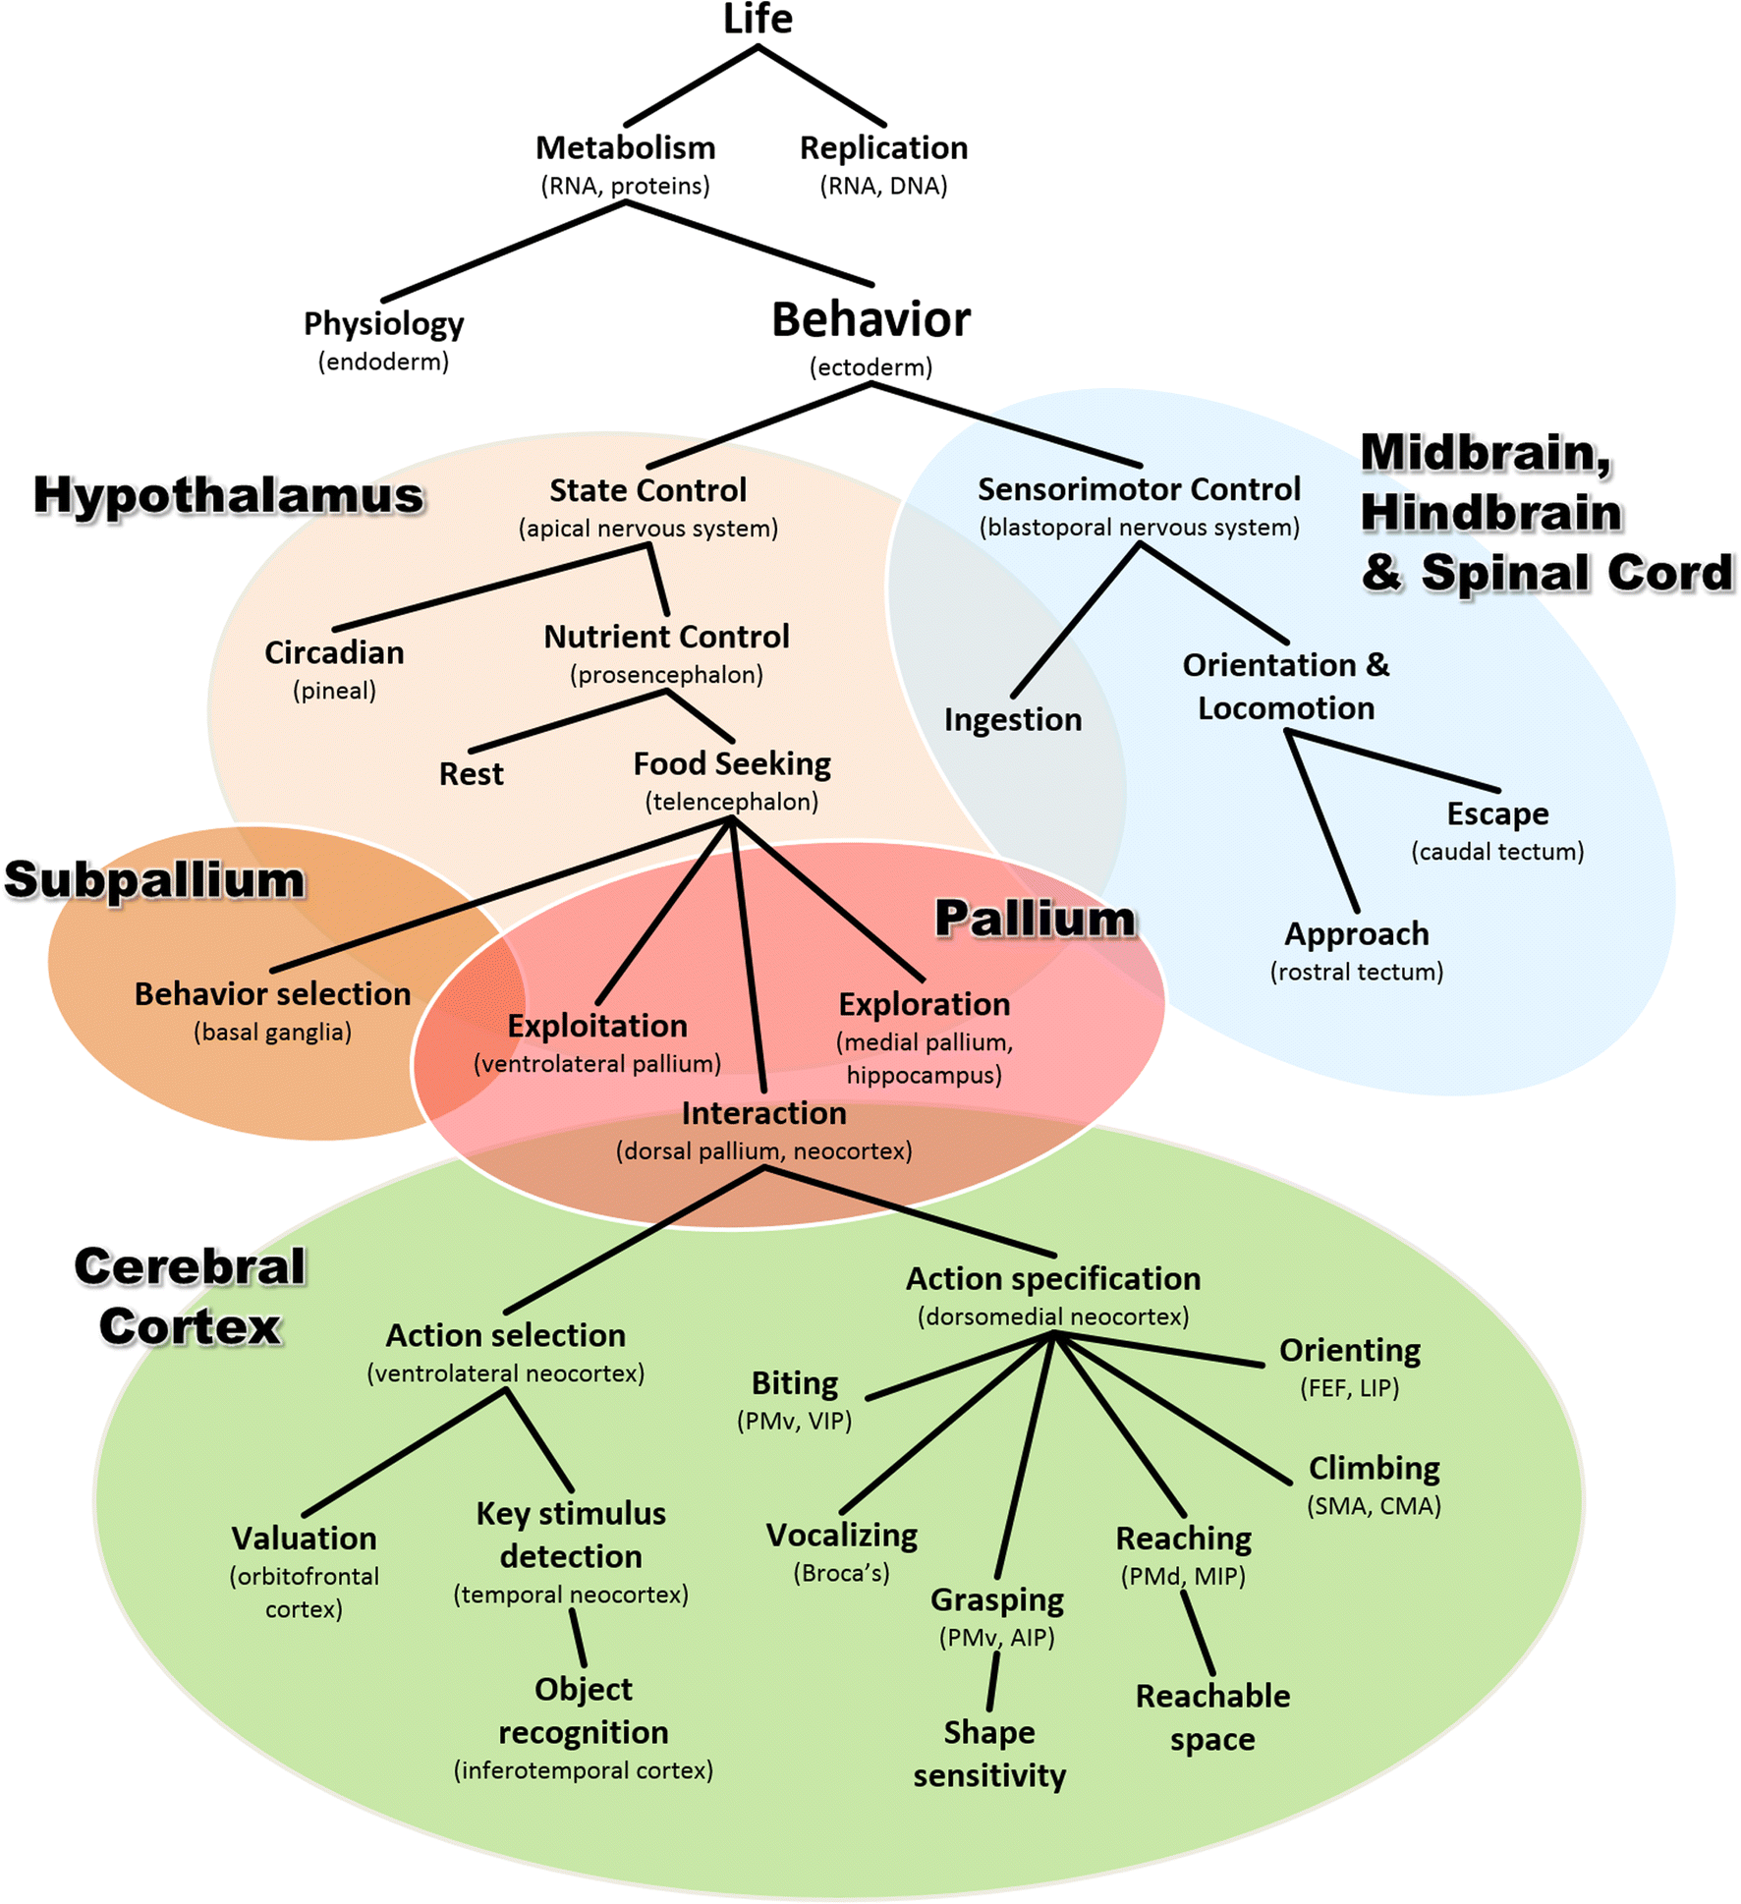
Mapping structures to functions…
Cisek (2019) Figure 8

Slide 46
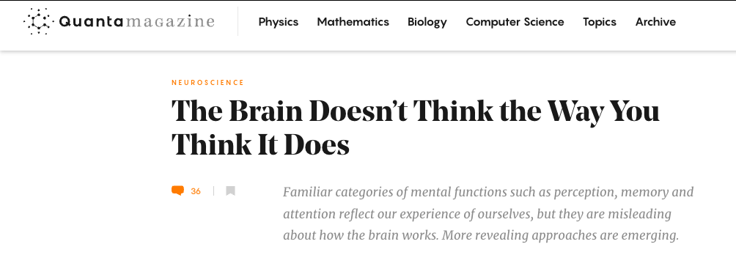
And vice versa?
Cepelewicz (2021)

Slide 47
“The brainwide representation of behavioral variables suggests that information encoded nearly anywhere in the forebrain is combined with behavioral state variables into a mixed representation…Our data indicate that it happens as early as primary sensory cortex.”
Stringer et al. (2019)

Slide 48
And do we have the right “psychological” structures?
Psychological sciences have identified a wealth of cognitive processes and behavioral phenomena, yet struggle to produce cumulative knowledge. Progress is hamstrung by siloed scientific traditions and a focus on explanation over prediction…
Eisenberg et al. (2019)

Slide 49
…two issues that are particularly damaging for the study of multifaceted constructs like self-regulation…We conclude that self-regulation lacks coherence as a construct…
Eisenberg et al. (2019)

Slide 50
“Behavioural biologists don’t agree on what constitutes behaviour”
Behavioural biology is a major discipline within biology, centred on the key concept of ‘behaviour’. But how is ‘behaviour’ defined, and how should it be defined? We outline what characteristics we believe a scientific definition should have, and why we think it is important…
Levitis, Lidicker, & Freund (2009)

Slide 51
…that a definition have these traits. We then examine the range of available published definitions for behaviour.
Levitis et al. (2009)

Slide 52
Finding no consensus, we present survey responses from 174 members of three behaviour-focused scientific societies as to their understanding of the term. Here again, we find surprisingly widespread disagreement as to what qualifies as behaviour. Respondents contradict themselves…
Levitis et al. (2009)

Slide 53
…each other, and published definitions, indicating that they are using individually variable intuitive, rather than codified, meanings of `behaviour.’
Levitis et al. (2009)

Slide 54
We offer a new definition, based largely on survey responses: “Behaviour is the internally coordinated responses (actions or inactions) of whole living organisms (individuals or groups) to internal and/or external stimuli, excluding responses more easily understood as developmental changes.”
Levitis et al. (2009)

Slide 55
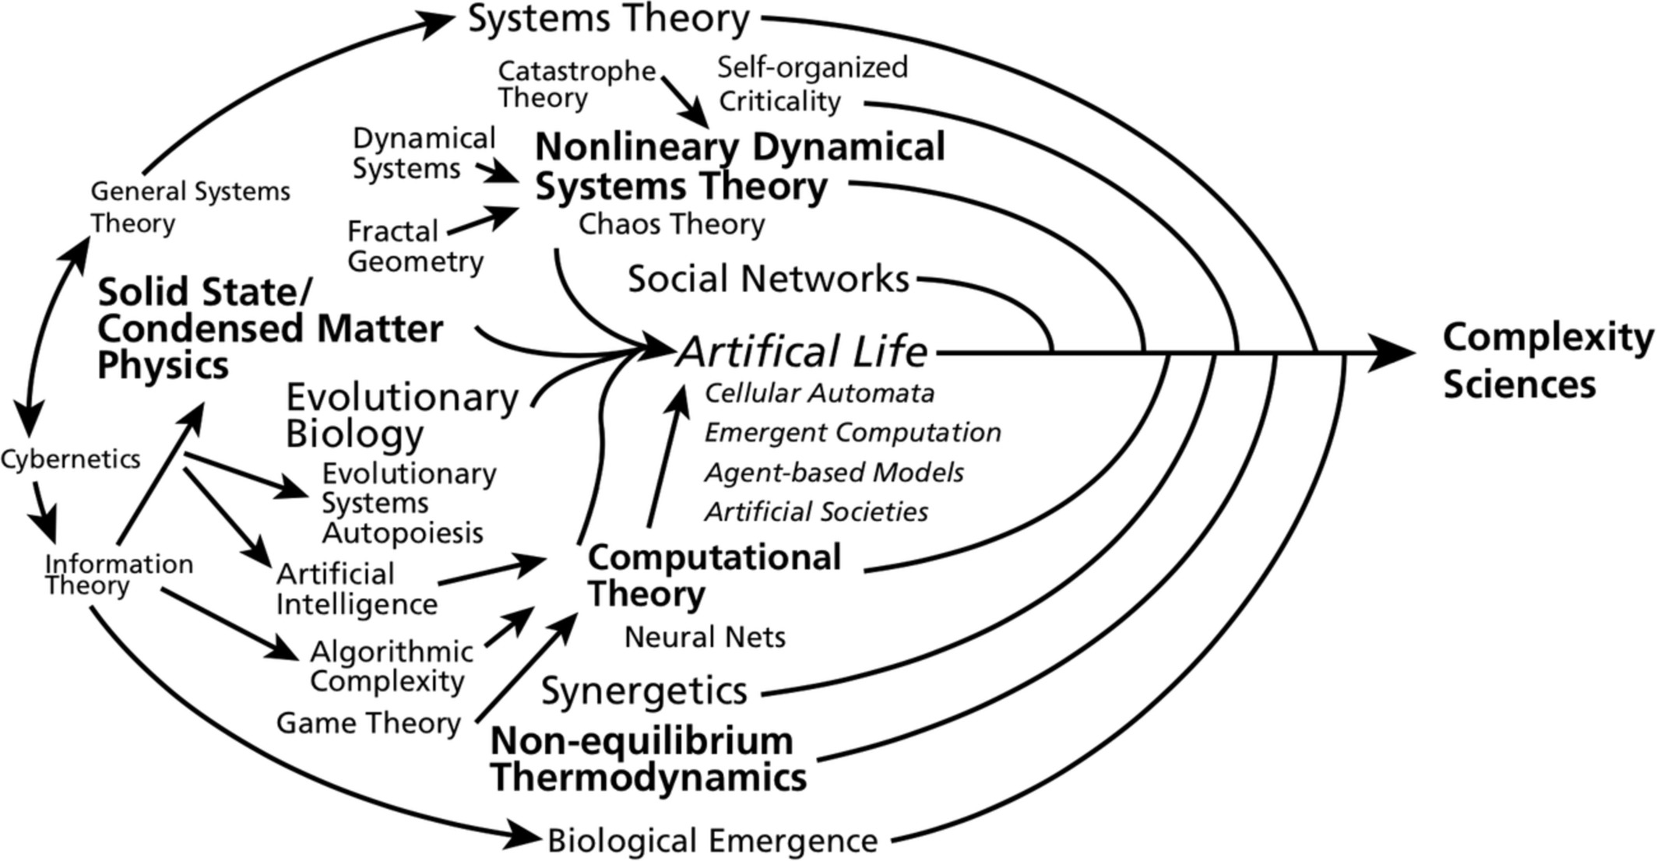
Sciences of complexity
Favela (2020) Figure 1

Slide 56
Levels of analysis
Sejnowski et al. (2014) Figure 1

Slide 57
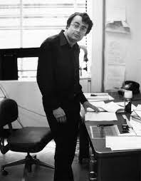

David Marr (1945-1980)
David Marr
Marr (1980)

Slide 58
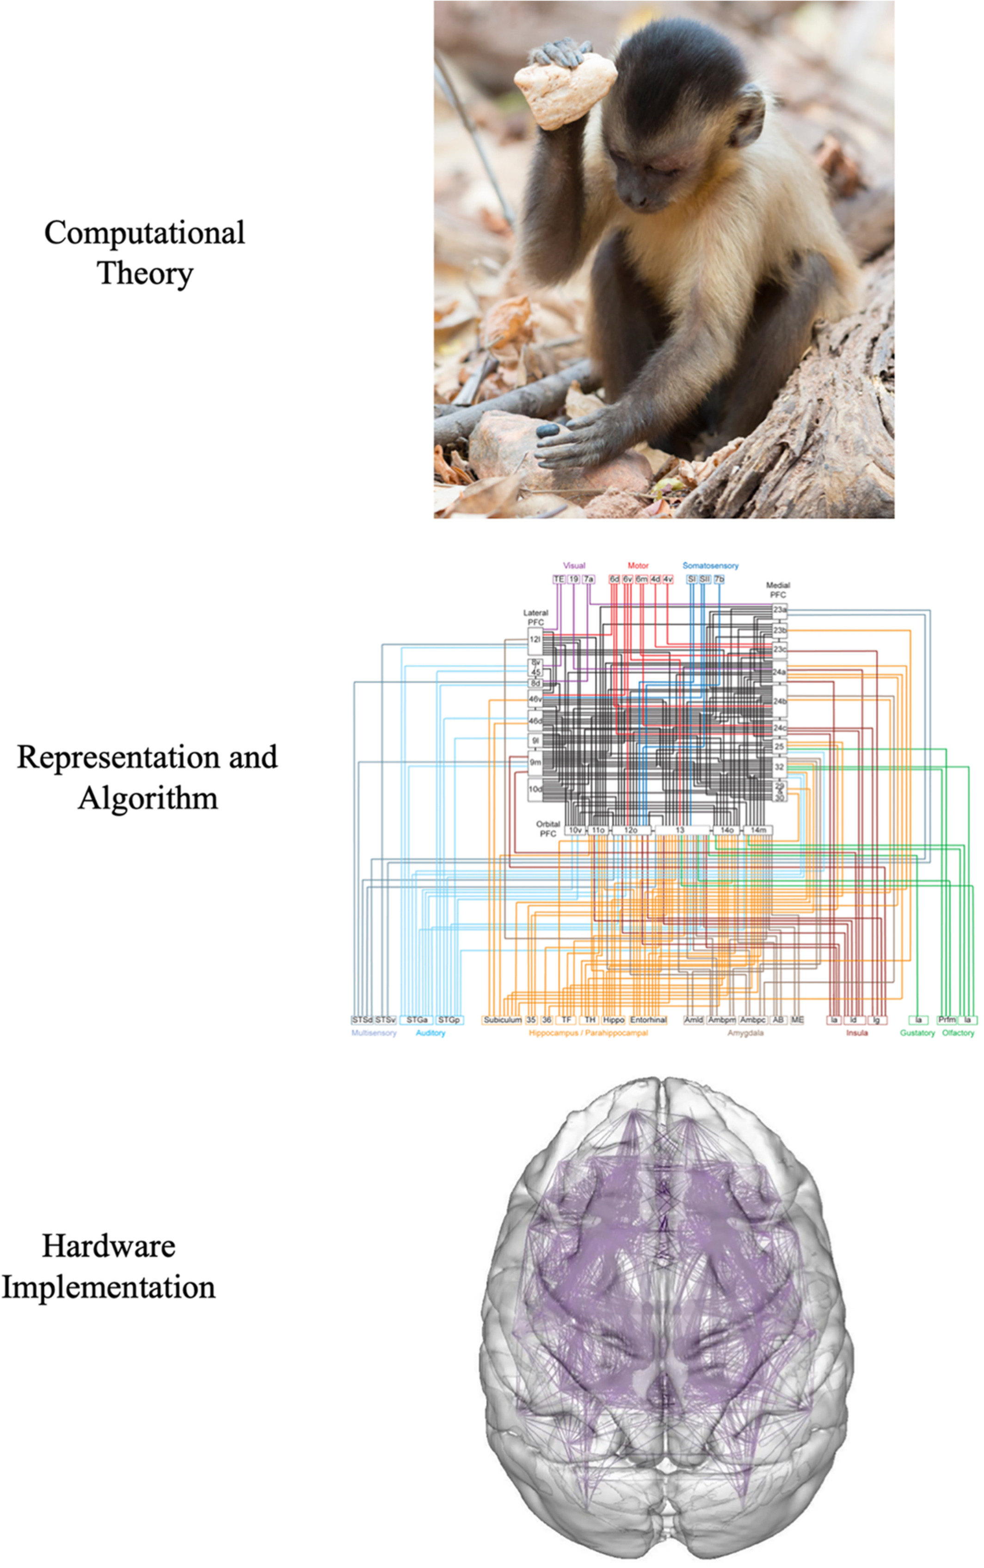
Marr’s Three Levels
Favela (2020) Figure 3

Slide 59
What must be computed to carry out task X?
What algorithm is used to carry out the computation?
What hardware implements the algorithm?

Slide 60
Computational level
What has to be computed?
What is the shape/form of that unknown object?
What did that person just say?
Is that unknown object a threat to me?

Slide 61
Algorithmic level
What’s the ‘recipe’ for…
computing shape
perceiving speech
recognizing threats

Slide 62
Implementation level
How do…
neurons
areas
networks
implement the recipe?

Slide 63
Causality in neuroscience
Siddiqi, Kording, Parvizi, & Fox (2022)
Stimulation & lesion studies needed for inferring causation.
Bradford-Hill criteria (Hill, 2015)

Slide 64
Varied notions of mechanism
Fig. 1: The narrow and broad notions of mechanism from Ross & Bassett (2024)

Slide 65
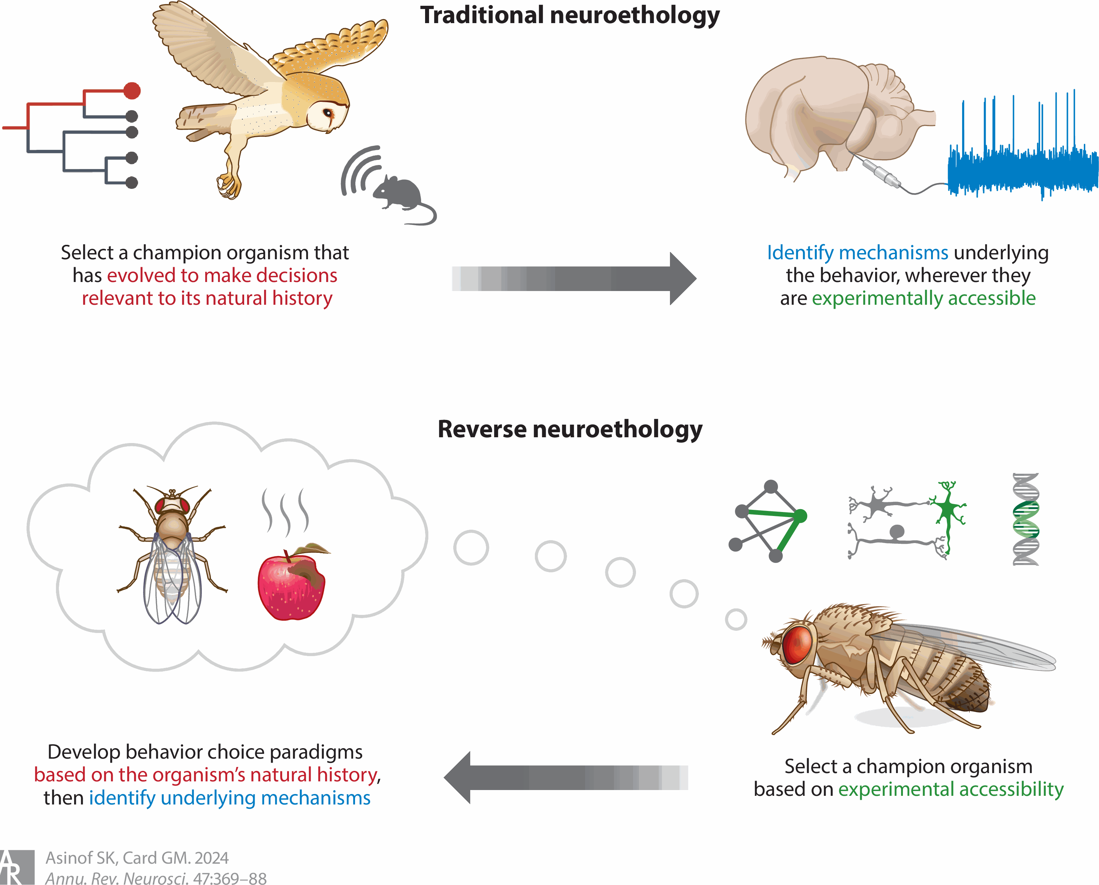
Toward reverse neuroethology
Figure 1 from Asinof & Card (2024)

Slide 66

https://giphy.com/clips/thefastsaga-fast-and-furious-saga-fate-of-the-DF34cUyak7TPs7D4GE

Slide 67
…when faced with a difficult question, we often answer an easier one instead, usually without noticing the substitution.
Kahneman (2013), p. 12 quoted in Krakauer, Ghazanfar, Gomez-Marin, MacIver, & Poeppel (2017)

Slide 68
Break

Slide 69
Your turn

Slide 70
Does neuroscience need behavior?
Krakauer, J. W., Ghazanfar, A. A., Gomez-Marin, A., MacIver, M. A., & Poeppel, D. (2017). Neuroscience needs behavior: Correcting a reductionist bias. Neuron, 93(3), 480–490. https://dx.doi.org/10.1016/j.neuron.2016.12.041.
Parada, F. J. & Rossi, A. (2018). If neuroscience needs behavior, what does psychology need? Frontiers in Psychology, 9, 433. https://doi.org/10.3389/fpsyg.2018.00433.

Slide 71
Key points
Questions ‘often tacit…belief in the reductionist program for understanding the link between brain and behavior’
Behavior -> understanding; neural interventions -> causality
Marr’s 3 levels (computation; algorithm; implementation)

Slide 72
But what is behavior?

Slide 73
“Behavioural biologists don’t agree on what constitutes behaviour”
…“Behaviour is the internally coordinated responses (actions or inactions) of whole living organisms (individuals or groups) to internal and/or external stimuli, excluding responses more easily understood as developmental changes.”
(Levitis et al., 2009)

Slide 74
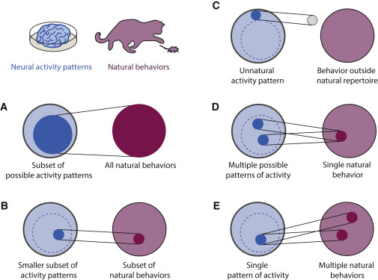
(Krakauer et al., 2017, fig. 1)

Slide 75
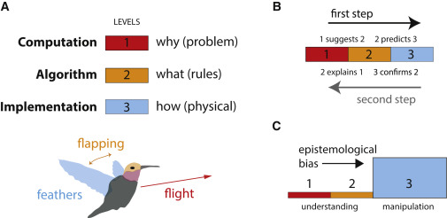
(Krakauer et al., 2017, fig. 2)

Slide 76
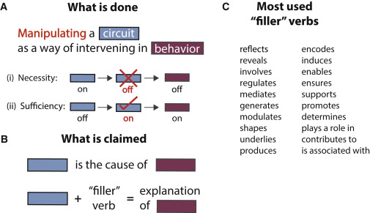
(Krakauer et al., 2017, fig. 3)

Slide 77
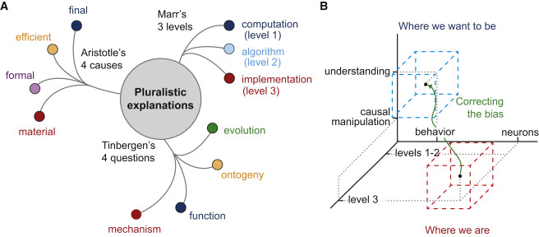
(Krakauer et al., 2017, fig. 4)

Slide 78
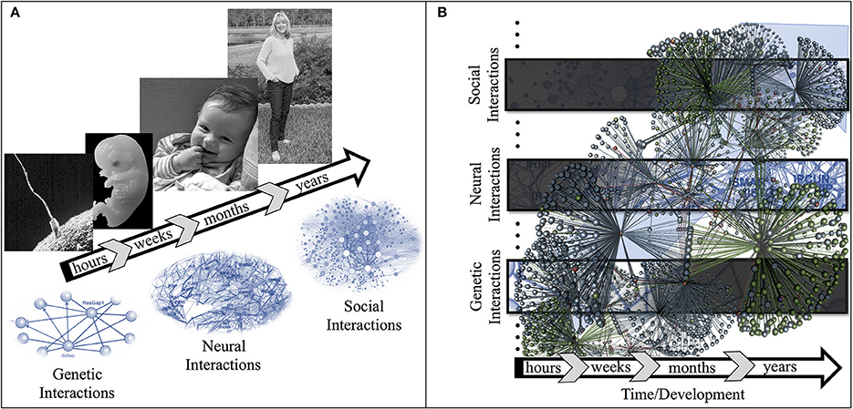
(Parada & Rossi, 2018, fig. 1)

Slide 79
Exercise 01
Due next Wednesday

Slide 80
Main points
Psychology is harder than physics
Neuroscience needs behavior
Psychology needs behavior + mental states + measures of environment

Slide 81
Next time…
Neuroanatomy lab
Read/study
Neuroanatomy notes
Bring to class a copy of Exercise 02

Slide 82
Resources

Slide 83
References
Asinof, S. K., & Card, G. M. (2024). Neural control of naturalistic behavior choices. Annual Review of Neuroscience, 47, 369–388. https://doi.org/10.1146/annurev-neuro-111020-094019
Becker, C. R. (2021, August 31). A comprehensive list of human-computer interactions. Retrieved January 8, 2025, from https://uxdesign.cc/a-comprehensive-list-of-human-computer-interactions-d72eaca2c0df
Calabrese, R. L. (2018). Inconvenient truth to principle of neuroscience. Trends in Neurosciences, 41(8), 488–491. https://doi.org/10.1016/j.tins.2018.05.006
Cepelewicz, J. (2021, August). Mental phenomena don’t map into the brain as expected. https://www.quantamagazine.org/mental-phenomena-dont-map-into-the-brain-as-expected-20210824/. Retrieved from https://www.quantamagazine.org/mental-phenomena-dont-map-into-the-brain-as-expected-20210824/
Cisek, P. (2019). Resynthesizing behavior through phylogenetic refinement. Attention, Perception & Psychophysics. https://doi.org/10.3758/s13414-019-01760-1
Eisenberg, I. W., Bissett, P. G., Zeynep Enkavi, A., Li, J., MacKinnon, D. P., Marsch, L. A., & Poldrack, R. A. (2019). Uncovering the structure of self-regulation through data-driven ontology discovery. Nature Communications, 10(1), 2319. https://doi.org/10.1038/s41467-019-10301-1
Favela, L. H. (2020). Cognitive science as complexity science. Wiley Interdisciplinary Reviews. Cognitive Science, 11(4), e1525. https://doi.org/10.1002/wcs.1525
Gilmore, R. O., Thomas, A. L., & Fesi, J. (2016). Children’s brain responses to optic flow vary by pattern type and motion speed. PloS One, 11, e0157911. https://doi.org/10.1371/journal.pone.0157911
Hill, A. B. (2015). The environment and disease: Association or causation? 1965. Journal of the Royal Society of Medicine, 108(1), 32–37. https://doi.org/10.1177/0141076814562718
Kahneman, D. (2013). Thinking, fast and slow (1st edition). Farrar, Straus; Giroux. Retrieved from https://www.amazon.com/Thinking-Fast-Slow-Daniel-Kahneman/dp/0374533555
Krakauer, J. W., Ghazanfar, A. A., Gomez-Marin, A., MacIver, M. A., & Poeppel, D. (2017). Neuroscience needs behavior: Correcting a reductionist bias. Neuron, 93(3), 480–490. https://doi.org/10.1016/j.neuron.2016.12.041
Levitis, D. A., Lidicker, W. Z., & Freund, G. (2009). Behavioural biologists don’t agree on what constitutes behaviour. Animal Behaviour, 78(1), 103–110. https://doi.org/10.1016/j.anbehav.2009.03.018
Marr, D. (1980). Vision. Retrieved from https://mitpress.mit.edu/books/vision
melodysheep. (2011, March). Ode to the brain! By symphony of science. Youtube. Retrieved from https://www.youtube.com/watch?v=JB7jSFeVz1U
National Geographic. (2014, January). Beautiful 3-D brain scans show every synapse | national geographic. YouTube. Retrieved from https://www.youtube.com/watch?v=nvXuq9jRWKE
Parada, F. J., & Rossi, A. (2018). If neuroscience needs behavior, what does psychology need? Frontiers in Psychology, 9, 433. https://doi.org/10.3389/fpsyg.2018.00433
Qian, Y., Berenbaum, S. A., & Gilmore, R. O. (2022). Vision contributes to sex differences in spatial cognition and activity interests. Scientific Reports, 12, 17623. https://doi.org/10.1038/s41598-022-22269-y
Ross, L. N., & Bassett, D. S. (2024). Causation in neuroscience: Keeping mechanism meaningful. Nature Reviews. Neuroscience. https://doi.org/10.1038/s41583-023-00778-7
Segal, A., Tiego, J., Parkes, L., Holmes, A. J., Marquand, A. F., & Fornito, A. (2024). Embracing variability in the search for biological mechanisms of psychiatric illness. Trends in Cognitive Sciences, 29, 85–99. https://doi.org/10.1016/j.tics.2024.09.010
Sejnowski, T. J., Churchland, P. S., & Movshon, J. A. (2014). Putting big data to good use in neuroscience. Nat. Neurosci., 17(11), 1440–1441. https://doi.org/10.1038/nn.3839
Siddiqi, S. H., Kording, K. P., Parvizi, J., & Fox, M. D. (2022). Causal mapping of human brain function. Nature Reviews Neuroscience, 23(6), 361–375. https://doi.org/10.1038/s41583-022-00583-8
Stringer, C., Pachitariu, M., Steinmetz, N., Reddy, C. B., Carandini, M., & Harris, K. D. (2019). Spontaneous behaviors drive multidimensional, brainwide activity. Science, 364(6437), 255. https://doi.org/10.1126/science.aav7893
Swanson, L. W. (2005). Anatomy of the soul as reflected in the cerebral hemispheres: Neural circuits underlying voluntary control of basic motivated behaviors. Journal of Comparative Neurology, 493(1), 122–131. https://doi.org/10.1002/cne.20733
Swanson, L. W., & Lichtman, J. W. (2016). From Cajal to connectome and beyond. Annual Review of Neuroscience, 39, 197–216. https://doi.org/10.1146/annurev-neuro-071714-033954

